Slide 1

NATIONAL RESEARCH
TOMSK POLYTECHNIC UNIVERSITY
P. Chubik
Rector
2019

Slide 2

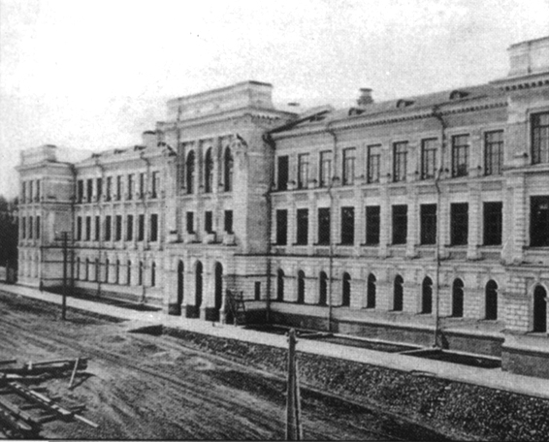
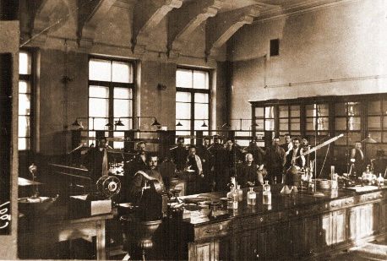
TPU Historical Background
TPU was founded as Tomsk Technological Institute on April 29 (May 11, new style) 1896 by the Decree of the Russian Emperor Nicholas II
TPU was opened on December 6 (18), 1900 as Tomsk Technological Institute of Emperor Nicholas II
Lectures started on October 9 (21), 1900
TPU served as the basis for more than three dozens of universities, academic and regional research institutes established in Novosibirsk, Krasnoyarsk, Omsk, Kemerovo, Irkutsk, Barnaul, Novokuznetsk, Tomsk and other cities of the country
2

Slide 3
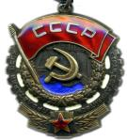
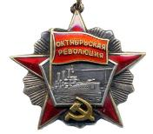
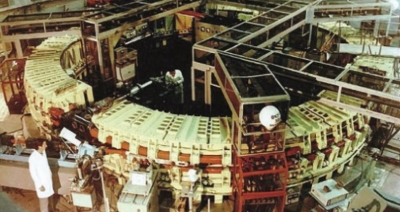
TPU Achievements
1940 – order of the Red Banner of Labor
1953 – commissioning of a television broadcast center, the first behind the Urals (fifth in the country)
1965 – start-up of synchrotron SIRIUS being the largest in the country (1.5 GeV)
1967 – launch of a research nuclear reactor, the second in the USSR and the only one behind the Urals
1971 – order of the October Revolution
3

Slide 4
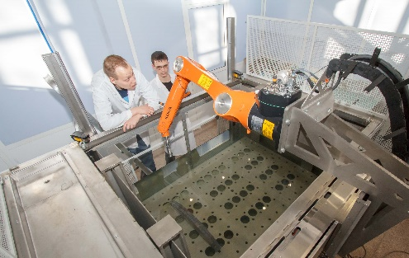

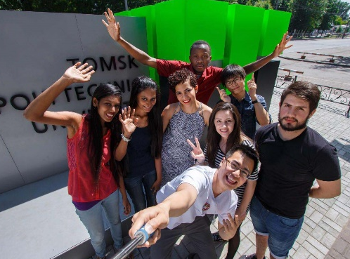
TPU Achievements
1997 – inclusion of TPU into the List of the Most Valuable Objects of Cultural Heritage of the Peoples of the Russian Federation under the Decree of the RF President
2009 – awarded category «National Research Tomsk Polytechnic University»
2013 – winner of the competition on Competitiveness Enhancement of the Leading Russian Universities among Global Leading Research and Education Centers
2005, 2016 – winner of the RF Government Award in the Field of Quality
4

Slide 5
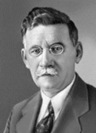
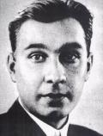
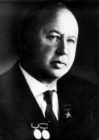
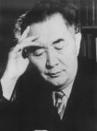
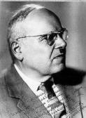
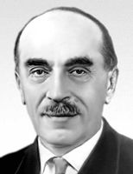
Among 180 000 graduates:
N.V. Nikitin
(1907–1973)
Designer and constructor of Ostankino TV tower, high-rise buildings of MSU and a number of other constructions. Graduated in 1930.
М.А. Usov
(1883–1939)
Academician of the USSR AS. Graduated in 1908.
М.L. Mil
(1909–1970)
Outstanding aircraft designer. TPI student from 1925 to 1928.
K.I. Satpaev
(1899–1964)
Academician of the USSR AS. Founder and the first president of
Kazakhstan AS. Graduated in 1926.
N.I. Kamov
(1902–1973)
Founder of Russian helicopter engineering. Graduated in 1923.
N.N. Semenov
(1896–1986)
Academician of the USSR AS. Nobel Prize winner in chemical kinetics.
Post-graduate student from 1918 to 1920.
5

Slide 6





International Rankings
Engineering and technology
201-250
5th in Russia after MSU, MIPT, HSE, MEPhI
501-600
2nd in Russia after MSU
11th in Russia after MSU, SPbU, NSU, BMSTU, TSU, MIPT, MGIMO, MEPhI, HSE
Engineering & Technology
277
9th in Russia after MSU, NSU, SPbU, MIPT, SPBU, BMSTU, MGIMO, ITMO, MISIS
387
10-12th in Russia together with HSE and SPbU after MSU, SPBU, MIPT, NSU, TSU, UrFU, ITMO, KFU, MISIS
Chemical Engineering
201-250
2nd in Russia after NSU
901-1000
ТОП-100
position in the world by subject Mechanical Engineering
The one and only Russian university in this subject area
New Moscow International University Ranking The Three University Missions
8th in Russia after MSU, SPbU, MIPT, HSE, MEPhI, NSU
76-100
205
6

Slide 7




National Rankings
RAEX Agency Ranking
7-th position after MSU, MIPT, MEPI, St.PSU, MGIMO, HSE
1-st position among non-capital universities
Рейтинг журнала Forbes
9-th position after MISIS, MGIMO, MIPT, MEPhI, MSU, RANEPA, ITMO, HSE
1-nd position among non-capital universities
National University Ranking, prepared by compiled by the International Information Group Interfax and the radio station Ekho Moskvy
8-th position after MSU, MEPhI, MPTI, HSE, St.PSU, NSU, TSU
Ranking of Vladimir Potanin Charitable Foundation
1-st position
7
Notes:
«

Slide 8
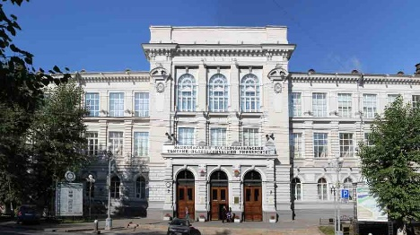
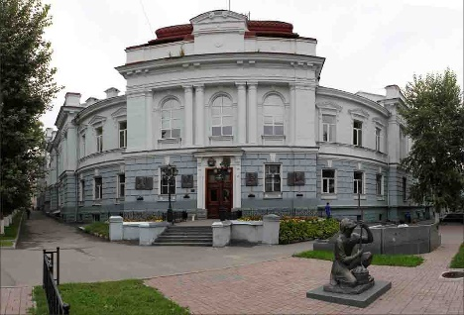
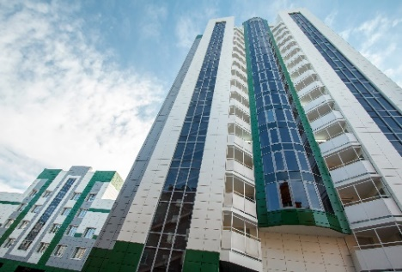
TPU Campus
TOTAL AREA – 329, 000 m²
29
university buildings
15
hostels
Science Park
8, 424 m² of sports facilities
International Culture Center
7, 500
computers
200
Wi-Fi zones
15
NGOs
TPU Library containing over
2.6 mln books
9
sports clubs
400-meter-long athletic facility of the Olympic standard
skiing lodge
artificial football pitch
rock climbing facility
25- meter swimming pool
TPU Campus – 1st place in the contest of the RF Ministry of Education and Science (2016)
7

Slide 9
TPU 2020 Target Model
TRIANGLE OF INNOVATIONS
unique integrated approach to research, engineering and entrepreneurship
focus on Asia thus ensuring innovations and training of engineering and scientific elite
equidistance from geographical centers of Russia, Asia and Eurasia
8

Slide 10








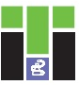

TPU Structure
School of Core Engineering Education
7 subdivisions: Mathematics & Computer Sciences, Natural Sciences, Social Sciences & Humanities, General Technical Subjects, Foreign Languages, Russian Language, Physical Education
School of Engineering Entrepreneurship
School of Nuclear Science & Engineering
– Division for Nuclear-Fuel Cycle
– Division for Experimental Physics
– The Weinberg Research Center
School of Non-Destructive Testing & Security
– Division for Electronic Engineering
– Division for Control and Diagnostics
School of Computer Science & Robotics
– Division for Information Technology
– Division for Automation and Robotics
School of Energy & Power Engineering
– Division for Power and Electrical Engineering
– The Butakov Research Center
School of Earth Sciences & Engineering
– Division for Geology
– Division for Oil and Gas Engineering
– Division for Chemical Engineering
School of Advanced Manufacturing Technologies
– Division for Materials Science
– The Kizhner Research Center
Research School of Chemistry & Applied Biomedical Sciences
Research School of High Energy Physics
9

Slide 11
Education
12169
875
256
1045
– Students
– Post-graduates
– Doctors of Science
– Candidates of Science
31
36
21
– Bachelor and Specialist
Degree programs
– Master Programs
– Post-Graduate
Cohort
Educational programs
387
professional development programs
41
professional
retraining programs
1, 000
e-courses
10

Slide 12
Education
NETWORK BACHELOR’S PROGRAMS
8 programs (158 students)
PROGRAMS IN ENGLISH
10 master’s programs (183 students)
1 specialist’s degree program (19 students)
NETWORK PROGRAMS AND DOUBLE DEGREE PROGRAMS
16 network master’s programs (10– with international partner universities)
12 partner organizations, 9 international
223 students
NETWORK MASTER’S PROGRAMS IMPLEMENTED WITH INTERNATIONAL PARTNER UNIVERSITIES:
Heriot-Watt University
University of Bourgogne-Franche-Comté
University Grenoble Alpes
Technical University of Munich
Anhalt University of Applied Sciences
Aachen University of Applied Sciences
Czech Technical University in Prague
Al-Farabi Kazakh National University
Almaty University of Power Engineering and Telecommunications
Karaganda State Technical University
11

Slide 13
Export of Educational Services
2, 601 students from 7 CIS countries
1, 172 students from 33 non-CIS countries
1, 852
567
98
52
23
8
1
– Kazakhstan
– Uzbekistan
– Kyrgyzstan
– Tajikistan
– Turkmenistan
– Ukraine
– Azerbaijan
491
68
– bachelors, specialists and masters
– post-graduates
231
382
– pre-university courses
– academic exchange programs
In 2018 TPU awarded diplomas to 725 - international students, including to 197 students from non-CIS countries: 130 bachelors, 1 specialist and 66 masters
12

Slide 14
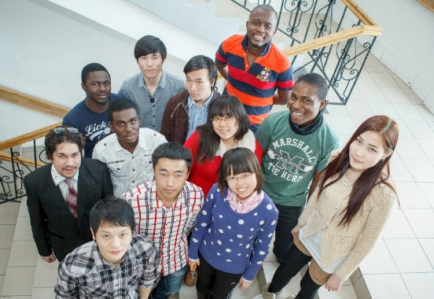
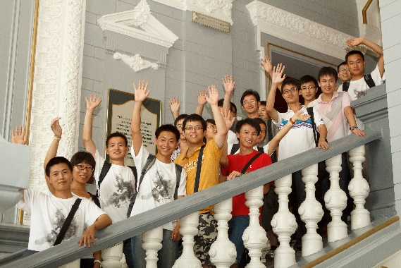
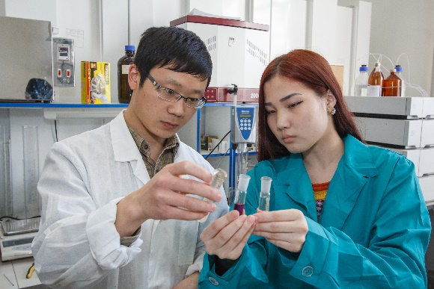
Academic Mobility
Outgoing:
In 2018, 372 TPU students received training (internship) in 176 universities and companies of 27 countries worldwide
Incoming:
In 2018, 346 students from 38 partner universities from 17 countries received training (internship) at TPU
13

Slide 15
Research
LEADING POSITIONS AMONG RUSSIAN UNIVERSITIES:
TECHNOLOGY ENTERPRENEURSHIP
In volume:
R&D (around 2,0 billions rubles) of international contracts and grants
R&D in the interest of industrial partners
In quantity:
Publications indexed by Web of Science, Scopus
Cited publications issued within the last 5 years in Web of Science and Scopus indexed titles
Russian patents
Thesis defenses
46 SIEs
> 170 work places
SIEs annual turnover
> 140 million rubles
UMNIK Competition
TPU is a leader among
the Universities of Tomsk
A managing company created for SIE TPU innovation zone – Managing Company Open Innovations TPU
14

Slide 16
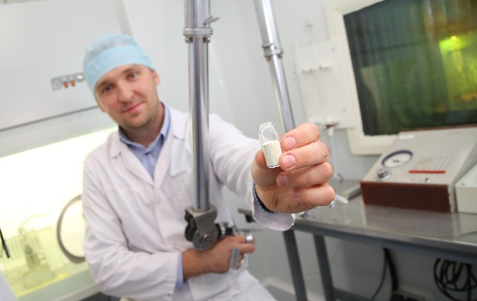
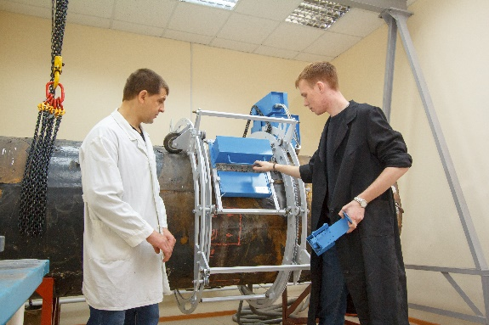
Research & Innovations
BREAKTHROUGH (FRONTIER) PROJECTS:
TPU nuclear research reactor for peaceful atom technologies: nuclear medicine, transmutation neutron alloying, isotope engineering, thorium power engineering
Beryllium production technology based on domestic high-fluoride materials
Effective technologies of hard-to-recover oil and gas resources
Solid fuel conversion technology into green gas
Tomography for remote identification in industry, medicine and counterterrorism
Technology for reagent-free water purification
15

Slide 17
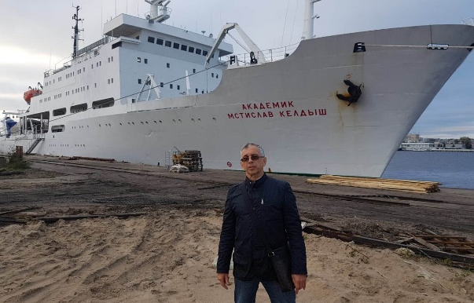
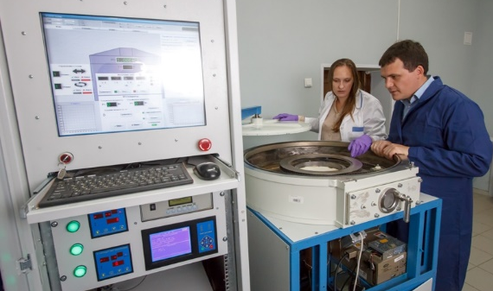
Research & Innovations
BREAKTHROUGH (FRONTIER) PROJECTS :
Studies of degradation of sub-sea permafrost and its influence on global climate change in the framework of the State Strategy for the Development of the Arctic Zone
New technologies of targeted drug delivery and genome editing
Physics and chemistry in cultivating living tissue, synthesis of biodegradable materials
New hybrid materials for medicine, plasmonics, photonics and organic electronics
Multi-level distributed information and telecommunication systems, group control of robotic complexes aimed to explore the World Ocean resources
16

Slide 18
Contribution to hi-tech production companies
TPU achievements under the RF Government Decree No. 218 on Measures of State Support for the Development of Cooperation of Russian Higher Educational Institutions and Organizations I Implementing Complex Projects Focused on High-Quality Production:
2013
Development and implementation of high-efficient technology to produce casing elements of aerospace equipment of a new generation (with Energy Aerospace Corporation and Institute of Strength Physics and Materials Science of the Siberian Branch of the Russian Academy of Sciences)
Development and manufacturing of geokhod – a multifunctional mining machine for subsurface construction (with Kemerovo Experimental Mechanical Repair Plant (KORMZ) and Institute of Coal of the Siberian Branch of the RAS)
2014
Development of a new technology for obtaining tungsten-containing products of enhanced quality
(with Zakamensk)
2016
Development and organization of high-tech production of scalable system of energy-efficient mechatronic devices and intelligent control systems for alternative energy and other applications (JSC Micran)
2017
Development of a software and hardware system for design, optimization and control of decommissioning of Russian and foreign nuclear facilities (JSC NEOLANT)
17

Slide 19
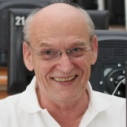
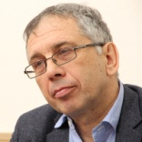
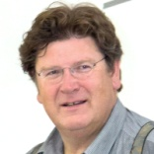
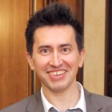
Laboratories under the supervision of foreign scientists
The following International Research and Educational Laboratories were established in frame of successful proposals following the RF Government Decree No. 220 on the Measure to Attract the Leading Scientists to Russian Institutions of Higher Professional Education:
2010 | 2013
Tomsk Open Laboratory for Material Inspection research supervisor Prof. Hans-Michael Kröning (Germany) | Arctic Sea's Carbon Research International Lab research supervisor Prof. Igor Semiletov (USA)
Laboratory of Hydrogen Power Engineering Technologies research supervisor Prof. Thorsteinn Ingi Sigfusson (Iceland) | Elderly People's Well-Being Improvement Technologies International Lab research supervisor Prof. Fabio Casati (Italy)
Laboratory of X-ray Optics was established together with the National Academy of Sciences of Armenia (research supervisor А. Mkrtchyan, Armenia)
Laboratory of Thermosetting Polymers established together with SIBUR-Holding as part of Research and Educational Center KHIMTECH (research supervisor Francis Verpoort, Belgium)
18

Slide 20
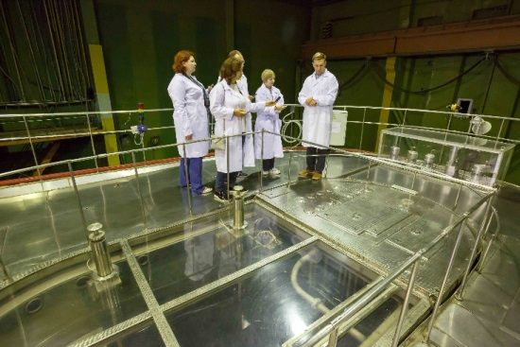
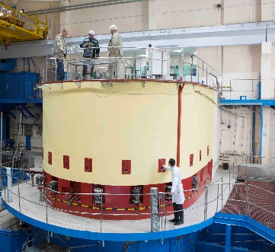
TPU Mega-Platforms
Science Park
Tomsk RASA
Center
Space
Technology
Center
Center of 3D-printing
In Space
Center of Resource Efficient
Subsurface Use
Metrology Center
Laboratory of Industrial
Robotics
Center of collective use Composition of Substances and Materials
Center for Geological Training in Khakassia
Research Nuclear Reactor
19

Slide 21

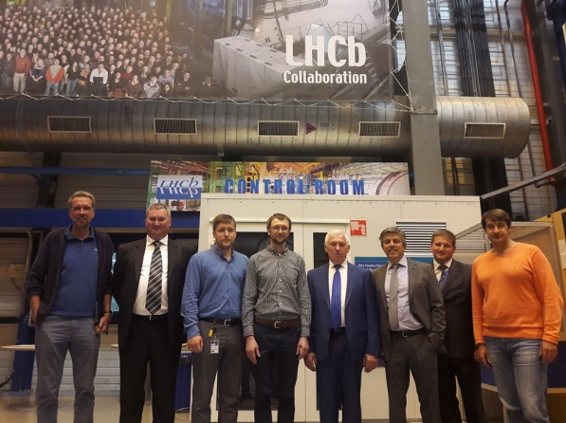
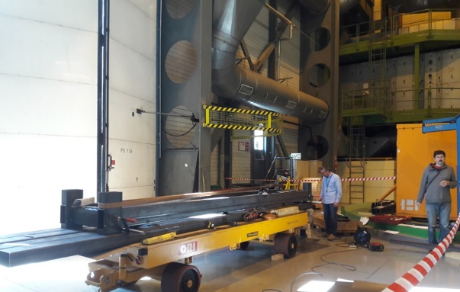
TPU and global research mega-platforms
THE EUROPEAN ORGANIZATION FOR NUCLEAR RESEARCH (CERN)
TPU takes part in 4 major experiments within CERN
TPU researchers commissioned by CERN to develop the following:
  The newest methods of diagnostics and management of proton beams in the Large Hadron Collider (in collaboration with international teams of researchers)
  Diamond and sapphire radiation-resistant detectors
In 2018, the first master’s thesis analyzing experimental data obtained from the Large Hadron Collider was developed in TPU
20

Slide 22
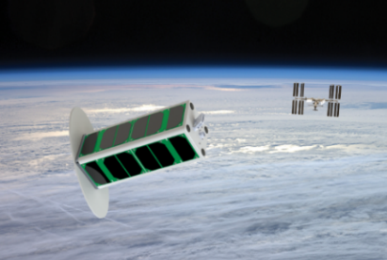
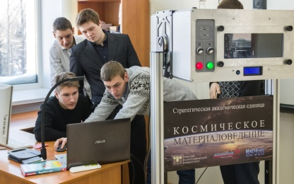
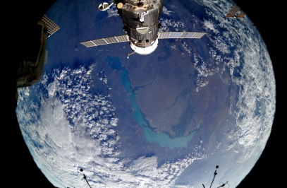
TPU and global research mega-platforms
INTERNATIONAL SPACE STATION (ISS)
Tomsk-TPU-120 satellite was designed and launched from the ISS to the outer space. It is the first Russian spacecraft designed using 3D-technologies and unique materials
The first Russian 3D printer operating in zero-gravity conditions was developed (Long-Term Program of Scientific and Applied Studies and Experiments planned in the Russian segment of the ISS)
Unique multilayer nanocomposite coatings for portholes of the Russian segment of the ISS as part of the large-scale space experiment Peresvet
21

Slide 23
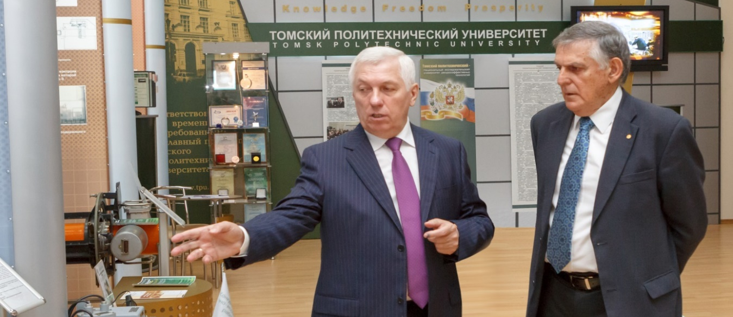
International Scientific Council
International Scientific Council (ISC) was established in TPU in 2014 and is composed of leading scientists of Austria, Canada, Germany, Israel, and Switzerland.
The Council is chaired by Dan Shechtman – Nobel Laureate in Chemistry 2011, Professor of Technion, the Israel Institute of Technology in Haifa, Professor of Iowa State University (USA), since 2016 the Foreign Member of the Russian Academy of Sciences
22

Slide 24

















Innovation Development Programs
17 innovation development programs, in 6 of which TPU acts as a base university:
Gazprom
Rosatom
ISS-Reshetnev Company
NPO Microgen
System Operator of the Unified Energy System of Russia (SO UPS)
RAO Energy Systems of the East (RAO ES of East)
ROSCOSMOS
Rosneft
Surgutneftegas
Transneft
ALROSA
Federal Grid Company of Unified Energy System
Rostec Corporation
Russian Railways
S.P. Korolev Rocket and Space Corporation Energia
All-Russian Scientific Research Institute of Aviation Materials
KAMAZ
23

Slide 25


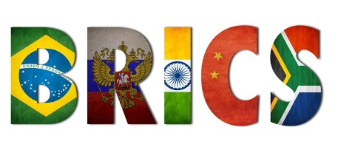
International Recognition
TPU is a member of 9 international associations and consortiums, including CESAER (Conference of European Schools for Advanced Engineering Education and Research), CLUSTER (Consortium of Leading European and Asian Technical Universities)
TPU is a participant of the BRICS Network University
Sino-Russian Think Tank in the framework of One Belt and One Road Initiative established at TPU jointly with the Chinese Academy of Science and Technology for Development (CASTED). Its strategic goal is to assess the social and economic impact of engineering solutions
24

Slide 26
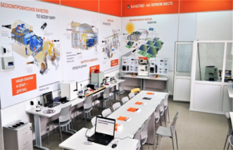




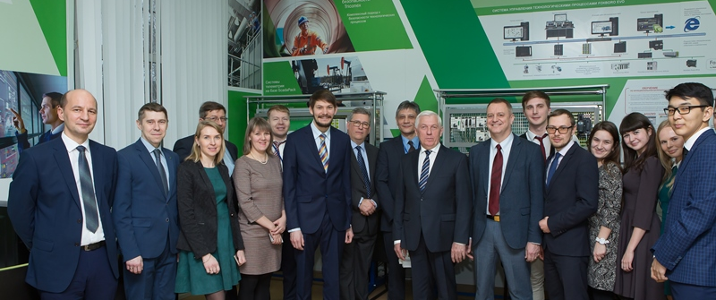


International Recognition
Research centers of world corporations-partners of TPU:
25

Slide 27
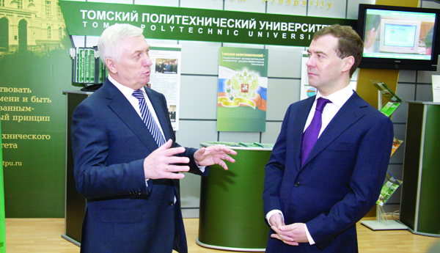
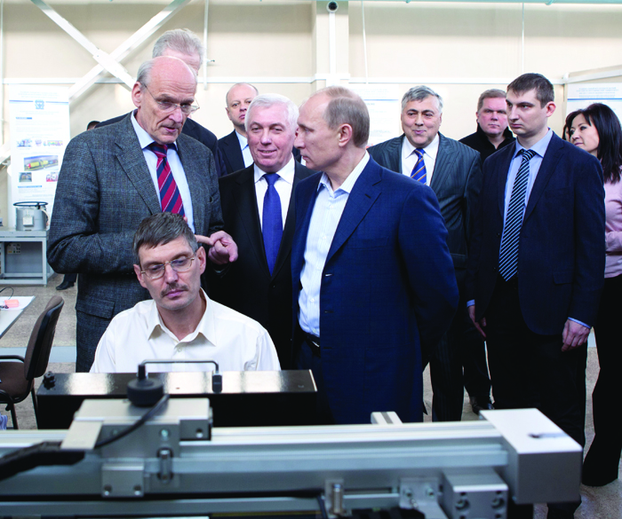
Visits by country leaders
11 February 2010 - President of the Russian Federation Dmitry A. Medvedev (at present the Prime Minister of the Russian Federation)
25 January 2012 – Prime Minister of the Russian Federation Vladimir V. Putin (since May 7, 2012 – the President of the Russian Federation)
26

Slide 28
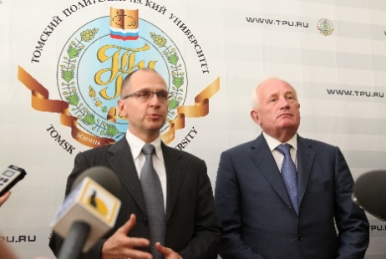
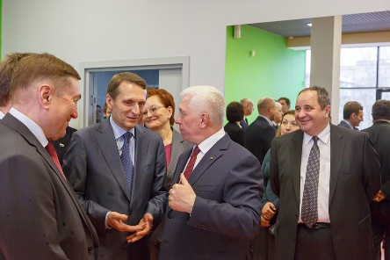
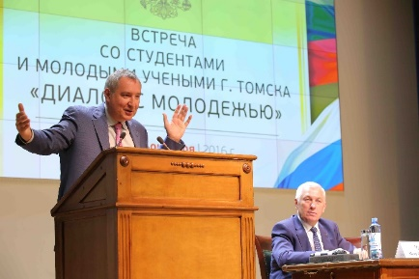
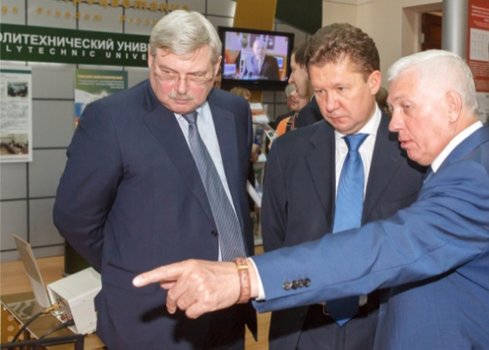
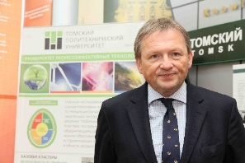
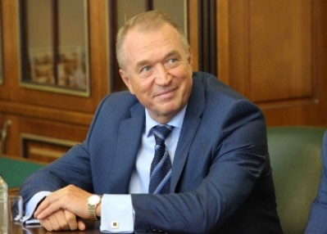
Other VIP guests at TPU from 2009 to 2018
Ambassadors of the following countries: Algeria, Belgium, Benin, Denmark, European Union, France, Germany, Great Britain, India, Indonesia, Iran, Ireland, Jordan, the Netherlands
Sergey Naryshkin, Chair of State Duma, currently – Director of Foreign Intelligence Service
Dmitri Rogozin, deputy Chair of the Russian Government, currently – General Director of the Roskosmos state corporation
Alexey Miller, Chair of Gazprom Board
Sergey Kirienko, General Director of the Rosatom state corporation, currently – First Deputy of Chief of Staff of the President of Russia
Sergey Katyrin, President of the industrial and commercial chamber of Russia
Anatolyi Chubais, General Director of ROSNANO
Boris Titov, Presidential Commissioner for Entrepreneurs’ Rights
And many others
27

Slide 29
Government Awards
Prize of the Government of the Russian Federation in education:
S.V. Kirsanov (2009)
М.G. Minin (2009)
TPU represented by P.S. Chubik, Yu.P. Pokholkov, A.I. Chuchalin and A.P. Surzhikov (2011)
Prize of the Government of the Russian Federation in science and technology for young scientists:
G.V. Kuznetsov, O.V. Vysokomornaya, D.O. Glushkov, A.V. Zakharevich, P.A. Strizhak (2012)
D.M. Sonkin (2014)
M.V. Andreev, N.Yu. Ruban, A.A. Suvorov, R.A. Ufa, Yu.S. Borovikov (2017)
Prize of the Government of the Russian Federation in science and technology:
M.A. Sonkin, V.Z. Yampolsky (2013)
M.M. Shtein (2013)
28

Slide 30

THANK YOU!

