Slide 1
How to work with TPU branded PPP template GUIDELINES
Designed for TPU students and employees
tpu.ru
14 December 2020

Slide 2
TOOLKIT
2
1.
3.
A support template that contains slide “design elements” and some slide layouts that you can copy into your new presentation, thereby speeding up preparation. SUPPORT TEMPLATE is not the file in which the presentation is created.
Guidelines for planning PowerPoint presentation
2.
Templates (PowerPoint ) 16:9 in dark and light backgrounds
The first 4 slides contain general facts about the university.
Delete the slides, if you don’t need them.
The files are saved in pptx (Power Point), which allows you to make all necessary adjustments and corrections to the presentation and save different versions of the file.

Slide 3
TOOLKIT
3
Emailing your presentation
To send your presentation by email, it is recommended that you save your presentation in PDF format
How to save as PDF?
Open your presentation in .pptx
Make all corrections required
Click File → Save as
Choose .pdf
Click Save
You presentation is converted into .pdf
This is the way to make your file more visually appealing, as well as prevent “unauthorized” adjustments, intentional/unintentional damage to information in the file.

Slide 4
POWER POINT TEMPLATES
4
All Power Power templates are provided in 16:9 ratio.
16:9 – a widescreen aspect ratio
optimized for:
Emailing your PP presentation;
Delivering it from the screens of modern computers / laptops / plasma displays.

Slide 5
FONTS
5
Consider using 20-40 pts Calibri for headings (bold). CAPITALIZATION is welcome.
Consider going no smaller than 14–20 pts Calibri for the content text (normal).
Consider using bold type to highlight some words in the text.
Consider using a dark background for the slide paired with a light color for the text and vice versa.

Slide 6
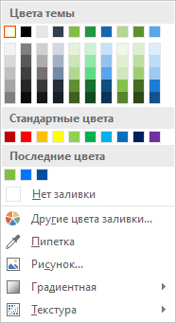
COLOR PALETTE FOR PP PRESENTATION
6
Recommended colors
Presentations come with four primary corporate colors
Primary colors
Some more variations of primary colors
128 191 68
0 0 0
Avoid using
255 255 255
0 78 164
Other four colors can be used
In the Shape Fill and Shape Outline drop-down boxes, you can choose colors from the created color scheme.
Avoid default colors.
0 118 251
35 188 172
249 175 25
247 237 106

Slide 7
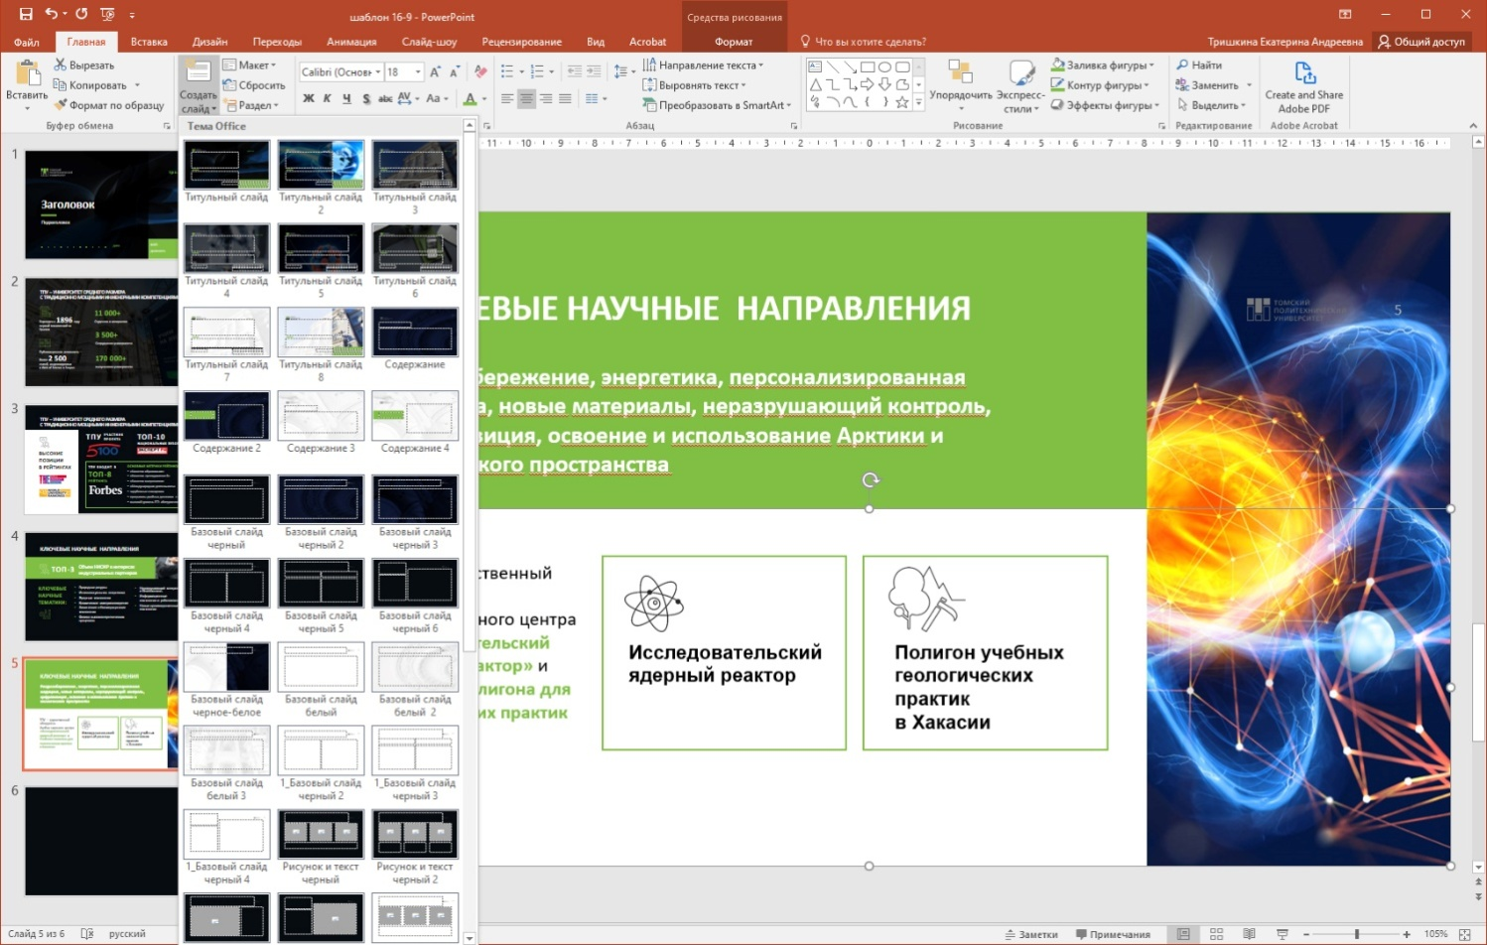
HOW TO DESIGN A PRESENTATION?
7
Presentation contains slide designs.
Design options are “embedded" into the file.
Design styles for dark and light backgrounds. You can use both templates in one presentation.
Fonts and corporate colors are also included in the source file. This will make it easier to work with the file.
They can be selected in:
1. MENU → Main → Create slide.
2. Select an option.
Note
A wide menu of slide designs is available, make sure you scroll it down.
All slide layouts have titles that feature their scope.

Slide 8
HOW TO DESIGN A PRESENTATION?
8
Title Master
There are several templates of the title slide available.
Certain placeholder fields for the presenter“s name and the date of report are designed to „personalize“ your presentation.
If this information is not required/not available, you can delete these placeholders.

Slide 9
HOW TO DESIGN A PRESENTATION?
9
Contents
You can use any of the available content templates.
If the content should include sub-points, it is recommended to copy the text in the placeholder from the Support Template file.

Slide 10
HOW TO DESIGN A PRESENTATION?
10
Standard Slides
This template provides several variants of „standard slides“ including titles and subtitles as well.
It is acceptable to join different variants of standard slides in one presentation.
The standard slides can be selected in:
MENU → Main → Create slide
The standard slides are available in white, black, and with graphics in light and dark backgrounds.

Slide 11
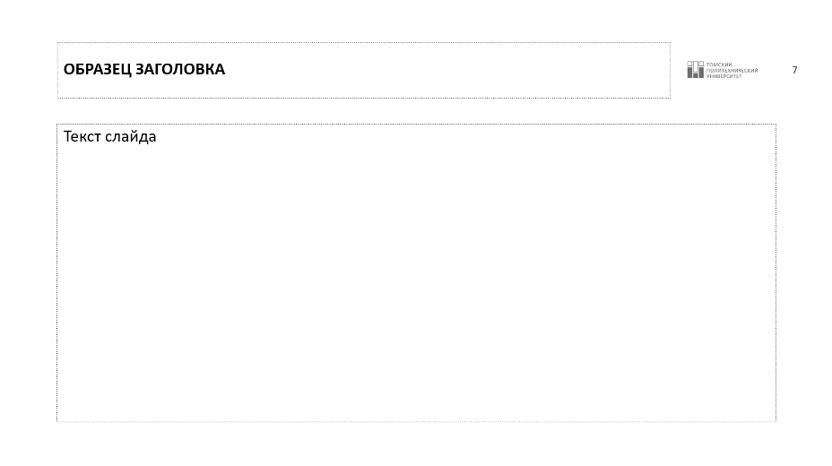
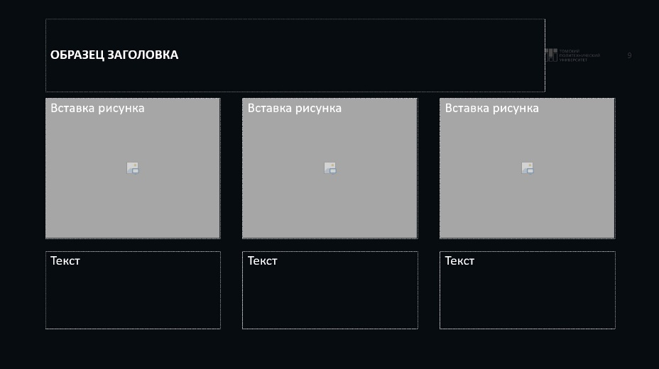
HOW TO DESIGN A PRESENTATION?
11
Standard Slides
The information of each slide can be presented and formated in different ways.
However, there are the key recommendations to be followed:
Avoid arranging the images and texts close to the slide margins
Make sure there is space between images and the text.
Avoid arranging the images and texts close to the slide title or the subtitles

Slide 12
HOW TO DESIGN A PRESENTATION?
12
Quotations
There are two Quote templates designed.
The backspark is not available in the Quote template. It allows you not to limit the length of the quote used.
The Quote template is also available in Support Template where you can copy it and paste in your presentation (the backspark is available here).

Slide 13
HOW TO DESIGN A PRESENTATION?
13
Divider Slides
There are several variants of divider slides designed to indicate the sections in presentation.
You can choose the same variant for all dividers in your presentation or use different divider slides in their due sequence.

Slide 14
HOW TO DESIGN A PRESENTATION?
14
Contacts
Aviod impersonalisation!
Present the contact's full name and position.
You can replace the data of one contant with the another one.
It is reasonable to present no more than two contacts to avoid overloading your audience.
The icons of networks are available in Support Template for copying.
The Contacts Template including photos are available in Support Template as well.

Slide 15
HOW TO DESIGN A PRESENTATION?
15
Contacts
There are different types of slides that have been created. You can use them to present a contact person, a speaker, an expert, an author, etc.
You can choose from the layouts without photos or with square or round photos.
In the help template, you will find an example of the "Contact" slide design with a photo.
Please note that the fields "expert" and "author" are fillable.
The photo must be big (i. е. face+ neck+ shoulders).
To make photos round:
Click on the image on the slide→ Format tab→ Crop button (not rather icon – the "crop” text under it) → Proportions > 1:1
Done! We have a square, now we will make a circle.
Click on the image on the slide → Format tab → Crop button (not rather icon – the "crop” text under it) → Crop to fit → Oval

Slide 16
CHARTS AND TABLES
Chart and table format
Use the recommended colors when making charts.
The location of the arcs in a pie chart should go from the largest value to the smallest.
Do not use 3-D charts.
Use Calibri 20–40 pt (bold) font, center alignment for the chart/table title, and Calibri 12–18 pt for captions.
Title and captions should always contrast with the background.
A chart/table title must not duplicate the slide title.
It is advisable to add textual explanations to charts and tables. Place them on the right or below a chart/table.

Slide 17
Examples of charts design
17
Chart name

Slide 18
Examples of tables design
18
Variant 1
Variant2
Category 1 | Category 2 | Category 3
Range 1 | 12 | 10
Range 2 | 15 | 24
Range 3 | 61 | 23
Category 1 | Category 2 | Category 3
Range 1 | 12 | 10
Range 2 | 15 | 24
Range 3 | 61 | 23

Slide 19
Examples of tables design
19
Variant 1
Variant 2
Category 1 | Category 2 | Category 3
Range 1 | 12 | 10
Range 2 | 15 | 24
Range 3 | 61 | 23
Category 1 | Category 2 | Category 3
Range 1 | 12 | 10
Range 2 | 15 | 24
Range 3 | 61 | 23

Slide 20
TRANSITIONS AND ANIMATION
20
The animation is a very important part of a presentation delivered live or online as a slide show.
Transition is the effect we see when flipping through slides. There are many of them (see PowerPoint → top menu → "Transitions"). You can set the speed, add sound, and customize transition effects.
Complex transitions should be generally avoided. It is recommended to use "shift", "opening", and "flow". Other transitions are also possible but they should correspond to the topic of a presentation – origami dove transitions do not suit a science/business presentation.
ANIMATION is the appearance, disappearance, change, and movement of objects. Animation helps to change size and color.
It is important to remember that this is not a cartoon but, rather, a tool for conveying information. Animation may and should be used.
To add animation effects to a text, images, shapes, or other objects in your presentation:
Select the text or object where you want to add animation.
Open the Animation tab and select an animation effect. → Click the Effect Options button and select the desired option.
To add a transition:
Select the slide you want to add a transition to. → In the Transitions tab, select a transition effect. → Select a transition to see how it will look.
Click the Effect Options button to select the direction and type of a transition. → Click the Preview button to see how the transition looks like.
To remove a transition, select Transitions → None.

Slide 21
RULES FOR WORKING WITH ICONS
21
You can use a set of branded icons in your presentation.
You can find them in the Help Template.
These icons are presented in three colors: white, black and green.
The size of the icons can be changed (but not more than 120%) without distorting the proportions.

Slide 22
RULES FOR WORKING WITH IMAGES
22
Use high resolution photos in your presentation
Do not change photo’s proportions (distortion).
Do not use too many photos on the slide.
Do not use photos with «watermarks».
Do not use somebody else’s photos without notifying the copyright holder.

Slide 23
Useful Resources
23
Pictures
Icons
pixabay.com
pexels.com
unsplash.com
flaticon.com
iconfinder.com
icons8.com

