Slide 1

NATIONAL RESEARCH
TOMSK POLYTECHNIC UNIVERSITY
P. Chubik
Rector
2018

Slide 2

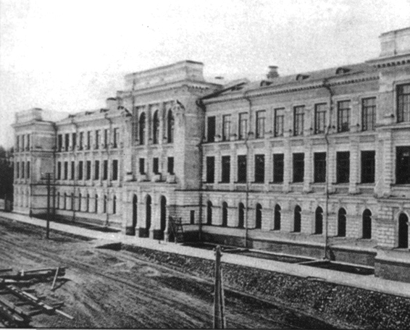
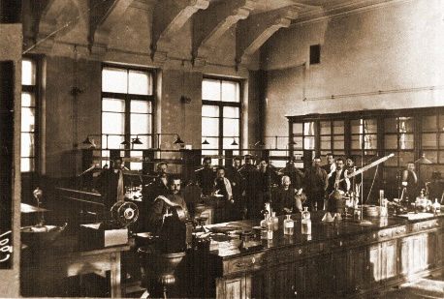
TPU Historical Background
TPU was founded as Tomsk Technological Institute on April 29 (May 11, new style) 1896 by the Decree of the Russian Emperor Nicholas II
TPU was opened on December 6 (18), 1900 as Tomsk Technological Institute of Emperor Nicholas II
Lectures started on October 9 (21), 1900
TPU served as the basis for more than three dozens of universities, academic and regional research institutes established in Novosibirsk, Krasnoyarsk, Omsk, Kemerovo, Irkutsk, Barnaul, Novokuznetsk, Tomsk and other cities of the country
2

Slide 3
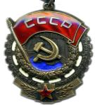
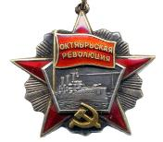
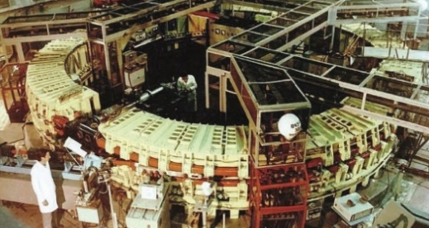
TPU Achievements
1940 – Order of the Red Banner of Labor
1947 – creation of the first compact 5 MeV electron accelerator (betatron) in the USSR
1953 – commissioning of a television broadcast center, the first behind the Urals (fifth in the country)
1965 – start-up of synchrotron SIRIUS being the largest in the country (1.5 GeV)
1967 – launch of a research nuclear reactor, the second in the USSR and the only one behind the Urals
1971 – Order of the October Revolution
1997 – inclusion of TPU into the List of the Most Valuable Objects of Cultural Heritage of the Peoples of the Russian Federation under the Decree of the RF President
3

Slide 4
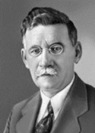
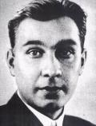
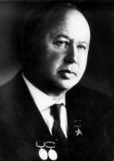
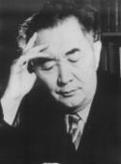
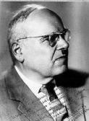
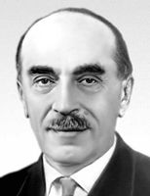
Among 172, 470 graduates:
N.V. Nikitin
(1907–1973)
Designer and constructor of Ostankino TV tower, high-rise buildings of MSU and a number of other constructions. Graduated in 1930.
М.А. Usov
(1883–1939)
Academician of the USSR AS. Graduated in 1908.
М.L. Mil
(1909–1970)
Outstanding aircraft designer. TPI student from 1925 to 1928.
K.I. Satpaev
(1899–1964)
Academician of the USSR AS. Founder and the first president of
Kazakhstan AS. Graduated in 1926.
N.I. Kamov
(1902–1973)
Founder of Russian helicopter engineering. Graduated in 1923.
N.N. Semenov
(1896–1986)
Academician of the USSR AS. Nobel Prize winner in chemical kinetics.
Post-graduate student from 1918 to 1920.
4

Slide 5
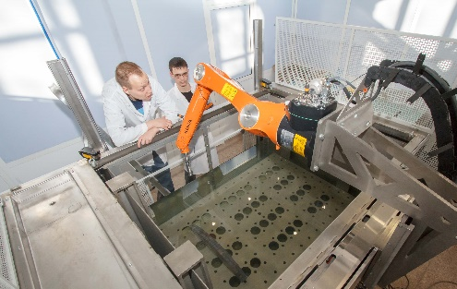

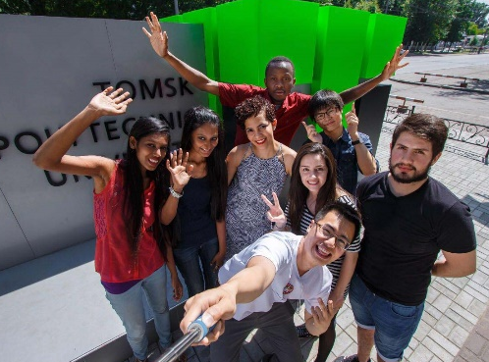
Main Facts
CATEGORY – National Research Tomsk Polytechnic University. Awarded in 2009.
WINNER OF THE COMPETITION on Competitiveness Enhancement of the Leading Russian Universities among Global Leading Research and Education Centers – 2013.
Winner of the RF Government Award in the Field of Quality – 2005, 2016.
One of 39 winners of the priority project on Export of Russian Education of the RF Ministry of Education and Science.
Winner of the competition HEIs as Centers of Innovation Creation of the RF Ministry of Education and Science.
5

Slide 6


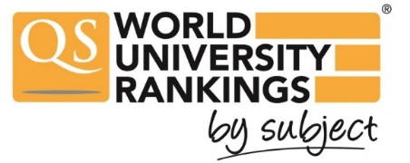




Rankings
Physical sciences
126-150
3th in Russia after MSU and MIPT
4-5th in Russia together with NSU after MIPT, MEPhI and MSU
301-350
Engineering and technology
151-175
10th in Russia after MSU, SPBU, NSU, BMSTU, TSU, MIPT, MGIMO, MEPhI, HSE
2nd in Russia after MSU
Engineering & Technology
386
285
New Moscow International University Ranking The Three University Missions
7th in Russia after MSU, SPBU, MIPT, HSE, MEPhI, NSU
6th in Russia after MSU, NSU, SPBU, MIPT, SPBU
151-200
Mechanical Engineering
136
The only Russian university
For the first time in QS Graduate Employability Rankings 2018
5th in Russia together with BMSTU, MEPhI, MIPT, MISIS, NSU and PRUE after MSU, SPBU, MGIMO and HSE
National rankings
8th in Russia after MSU, MIPT, MEPhI, SPBU, MGIMO, HSE and BMSTU
1st among nonmetropolitan universities
301-500
6

Slide 7
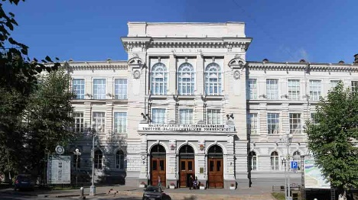
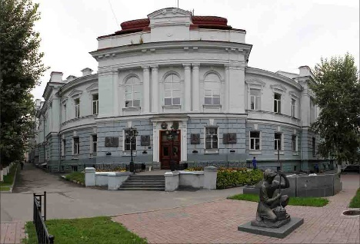
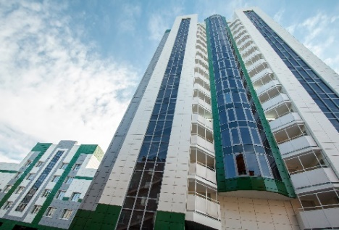
TPU Campus
TOTAL AREA – 329, 000 m²
29
university buildings
15
hostels
Science Park
8, 424 m² of sports facilities
International Culture Center
7, 500
computers
200
Wi-Fi zones
15
NGOs
TPU Library containing over
2.6 mln books
9
sports clubs
400-meter-long athletic facility of the Olympic standard
skiing lodge
artificial football pitch
rock climbing facility
25- meter swimming pool
TPU Campus – 1st place in the contest of the RF Ministry of Education and Science (2016)
7

Slide 8
TPU 2020 Target Model
TRIANGLE OF INNOVATIONS
unique integrated approach to research, engineering and entrepreneurship
focus on Asia thus ensuring innovations and training of engineering and scientific elite
equidistance from geographical centers of Russia, Asia and Eurasia
8

Slide 9








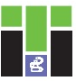

TPU Structure
School of Core Engineering Education
7 subdivisions: Mathematics & Computer Sciences, Natural Sciences, Social Sciences & Humanities, General Technical Subjects, Foreign Languages, Russian Language, Physical Education
School of Engineering Entrepreneurship
Engineering School of Nuclear Science & Engineering
– Division for Nuclear-Fuel Cycle
– Division for Experimental Physics
– The Weinberg Research Center
Engineering School of Non-Destructive Testing & Security
– Division for Electronic Engineering
– Division for Control and Diagnostics
Engineering School of Computer Science & Robotics
– Division for Information Technology
– Division for Automation and Robotics
Engineering School of Energy & Power Engineering
– Division for Power and Electrical Engineering
– The Butakov Research Center
Engineering School of Earth Sciences & Engineering
– Division for Geology
– Division for Oil and Gas Engineering
– Division for Chemical Engineering
Engineering School of Advanced Manufacturing Technologies
– Division for Materials Science
– The Kizhner Research Center
Research School of Chemistry & Applied Biomedical Sciences
Research School of High Energy Physics
9

Slide 10
Education
12500
887
8
222
918
– Students
– Post-graduates
– Doctoral students
– Doctors of Science
– Candidates of Science
30
36
21
30
– Bachelor programs
– Master Programs
– Post-Graduate Programs
– Doctoral Programs
Cohort
Educational programs
300
professional development programs
67
professional
retraining programs
1, 000
e-courses
10

Slide 11
Education
NETWORK MASTER PROGRAMS
FOREIGN PARTNER UNIVERSITIES ENGAGED IN NETWORK MASTER PROGRAMS:
Heriot-Watt University
Technical University of Munich
Technical University of Berlin
Anhalt University of Applied Sciences
Aachen University of Applied Sciences
Czech Technical University in Prague
Université Grenoble Alpes
Universite d'Orleans
Al-Farabi Kazakh National University
Almaty University of Power Engineering and Telecommunications
Karaganda State Technical University
18 programs (13 – with foreign partner universities)
15 partner universities, 11 of which are foreign universities
NETWORK BACHELOR PROGRAMS
7 programs
foreign partner universities :
  Jilin University (China)
  Shenyang Ligong University (China)
11

Slide 12
Export of Educational Services
2, 641 students from 8 CIS countries
1, 172 students from 31 non-CIS countries
1, 792
695
85
39
19
7
3
1
– Kazakhstan
– Uzbekistan
– Kyrgyzstan
– Tajikistan
– Turkmenistan
– Ukraine
– Azerbaijan
– Moldova
491
68
– bachelors, specialists and masters
– post-graduates
231
382
– pre-university courses
– academic exchange programs
In 2017 TPU awarded diplomas to 732 - international students, including to 193 students from non-CIS countries: 101 bachelors, 17 specialists and 75 masters
12

Slide 13
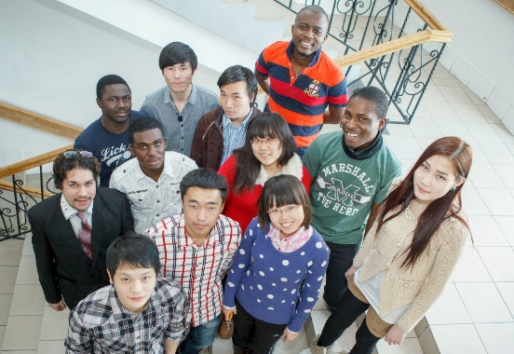
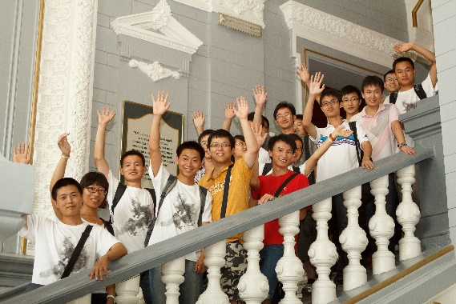
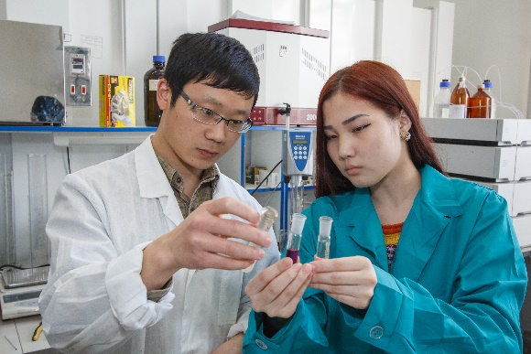
Academic Mobility
Outgoing:
In 2017, 347 TPU students received training (internship) in 184 universities and companies of 29 countries worldwide
Incoming:
In 2017, 375 students from 38 partner universities from 16 countries received training (internship) at TPU
13

Slide 14
Research & Innovations
LEADER AMONG RUSSIAN
UNIVERSITIES:
TECHNOLOGICAL
ENTREPRENEURSHIP
in international patents
in international contracts, programs and grants
48 small
university
spin-offs
> 200 work places
2.2 bln rub. – R&D volume (2nd in Russia)
1, 320 mln rub. – R&D volume for the benefit of industry (3rd in Russia)
220 mln rub. – income from international contracts (1st in Russia)
100 start-ups
turnover of innovative
companies is
> 1 bln rub. per year
14

Slide 15
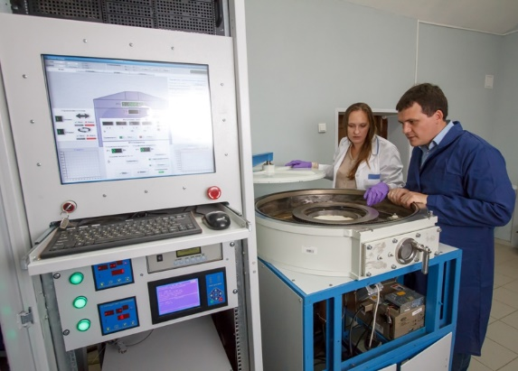
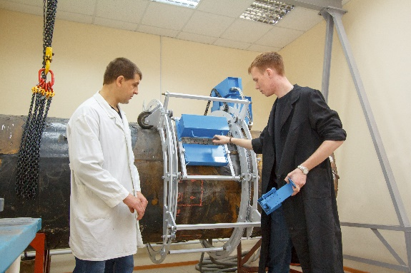
Research & Innovations
BREAKTHROUGH (FRONTIER) PROJECTS:
New technologies of targeted drug delivery and genome editing
New hybrid materials for medicine, plasmonics, photonics and organic electronics
Beryllium production technology based on domestic high-fluoride materials
Tomography for remote identification in industry, medicine and counterterrorism
Big Data analytics and technologies
Multi-level distributed information and telecommunication systems, group control of robotic complexes aimed to explore the World Ocean resources
15

Slide 16
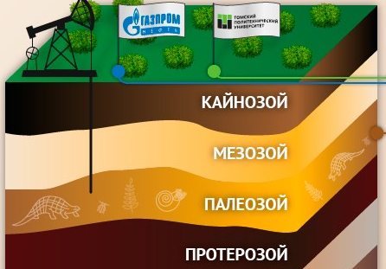
Research & Innovations
BREAKTHROUGH (FRONTIER) PROJECTS :
Studies of degradation of sub-sea permafrost and its influence on global climate change in the framework of the State Strategy for the Development of the Arctic Zone
Effective technologies of hard-to-recover oil and gas resources
TPU nuclear research reactor for peaceful atom technologies: nuclear medicine, transmutation neutron alloying, isotope engineering, thorium power engineering
Physics and chemistry in cultivating living tissue, synthesis of biodegradable materials
Solid fuel conversion technology into green gas
16

Slide 17
Contribution to hi-tech production companies
TPU achievements under the RF Government Decree No. 218 on Measures of State Support for the Development of Cooperation of Russian Higher Educational Institutions and Organizations I Implementing Complex Projects Focused on High-Quality Production:
2013
Development and implementation of high-efficient technology to produce casing elements of aerospace equipment of a new generation (with Energy Aerospace Corporation and Institute of Strength Physics and Materials Science of the Siberian Branch of the Russian Academy of Sciences)
Development and manufacturing of geokhod – a multifunctional mining machine for subsurface construction (with Kemerovo Experimental Mechanical Repair Plant (KORMZ) and Institute of Coal of the Siberian Branch of the RAS)
2014
Development of a new technology for obtaining tungsten-containing products of enhanced quality
(with Zakamensk)
2016
Development and organization of high-tech production of scalable system of energy-efficient mechatronic devices and intelligent control systems for alternative energy and other applications (JSC Micran)
2017
Development of a software and hardware system for design, optimization and control of decommissioning of Russian and foreign nuclear facilities (JSC NEOLANT)
17

Slide 18
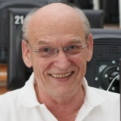
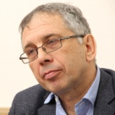
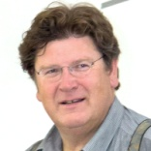
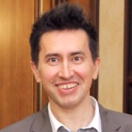
Laboratories under the supervision of foreign scientists
The following International Research and Educational Laboratories were established in frame of successful proposals following the RF Government Decree No. 220 on the Measure to Attract the Leading Scientists to Russian Institutions of Higher Professional Education:
2010 | 2013
Tomsk Open Laboratory for Material Inspection research supervisor Prof. Hans-Michael Kröning (Germany) | Arctic Sea's Carbon Research International Lab research supervisor Prof. Igor Semiletov (USA)
Laboratory of Hydrogen Power Engineering Technologies research supervisor Prof. Thorsteinn Ingi Sigfusson (Iceland) | Elderly People's Well-Being Improvement Technologies International Lab research supervisor Prof. Fabio Casati (Italy)
Laboratory of X-ray Optics was established together with the National Academy of Sciences of Armenia (research supervisor А. Mkrtchyan, Armenia)
Laboratory of Thermosetting Polymers established together with SIBUR-Holding as part of Research and Educational Center KHIMTECH (research supervisor Francis Verpoort, Belgium)
In 2012:
18

Slide 19
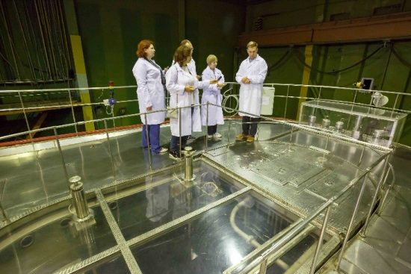
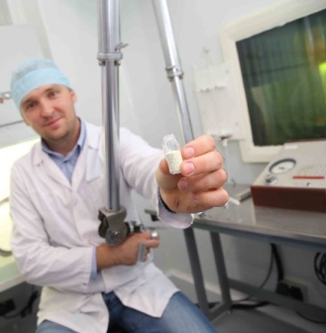
TPU Mega-Platforms
Science Park
Tomsk RASA
Center
Space
Technology
Center
Center of 3D-printing
In Space
Center of Resource Efficient
Subsurface Use
Metrology Center
Laboratory of Industrial
Robotics
Center of collective use Composition of Substances and Materials
Center for Geological Training in Khakassia
Research Nuclear Reactor
19

Slide 20
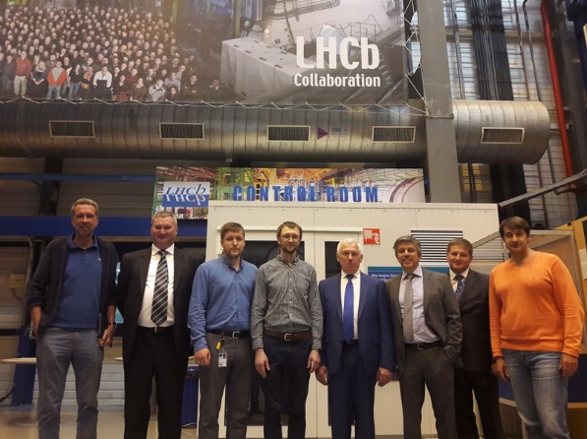
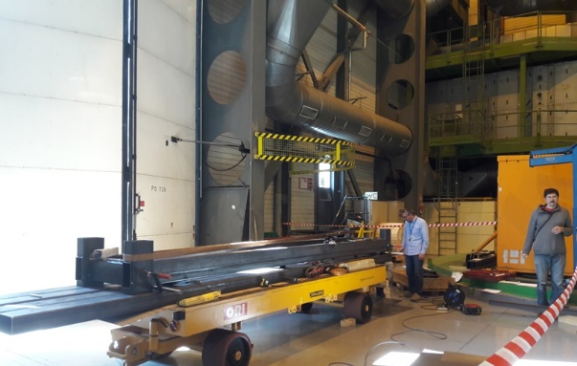
TPU and global research mega-platforms
EUROPEAN ORGANIZATION FOR NUCLEAR RESEARCH (CERN)
Over the past two years TPU became an active participant of 6 CERN collaborations, including 4 global experiments
TPU jointly with its foreign counterparts develop advanced methods for diagnostics and control of proton beams within the Large Hadron Collider, and analyze diamond detectors
The first parts of a rail system of the track detector at LHCb were developed and supplied to CERN
20

Slide 21
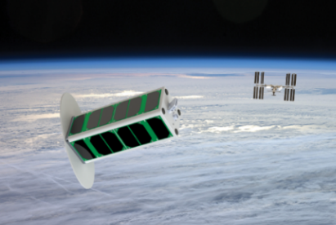
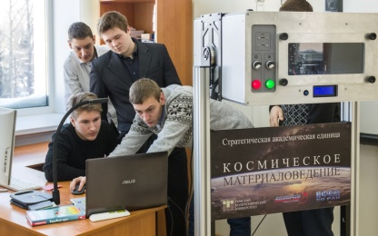
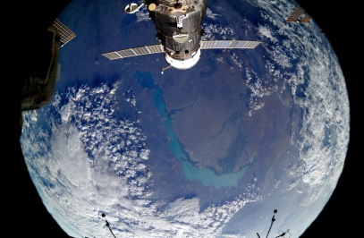
TPU and global research mega-platforms
INTERNATIONAL SPACE STATION (ISS)
Tomsk-TPU-120 satellite was designed and launched from the ISS to the outer space. It is the first Russian spacecraft designed using 3D-technologies and unique materials
The first Russian 3D printer operating in zero-gravity conditions was developed (Long-Term Program of Scientific and Applied Studies and Experiments planned in the Russian segment of the ISS)
Unique multilayer nanocomposite coatings for portholes of the Russian segment of the ISS as part of the large-scale space experiment Peresvet
21

Slide 22
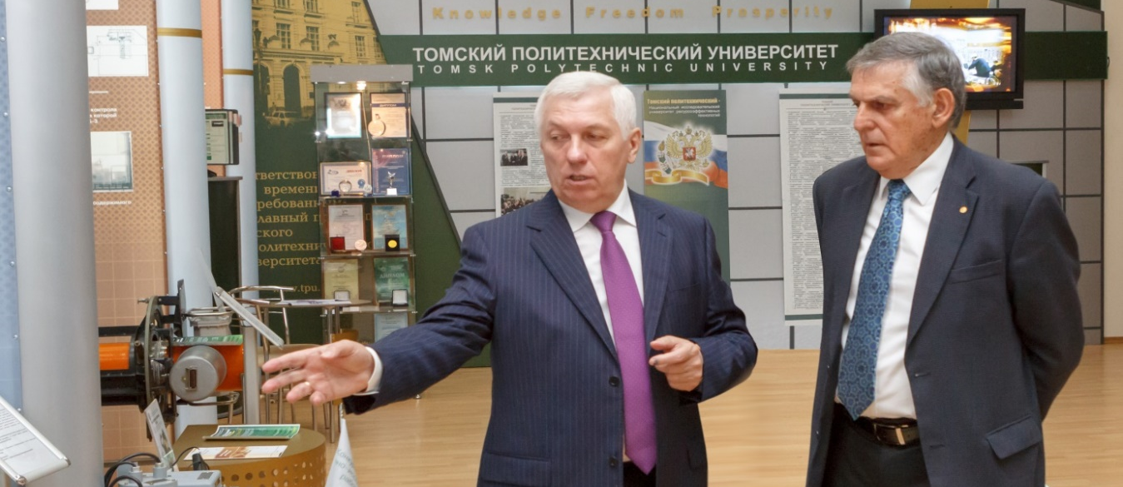
International Scientific Council
International Scientific Council (ISC) was established in TPU in 2014 and is composed of leading scientists of Austria, Canada, Germany, Israel, and Switzerland.
The Council is chaired by Dan Shechtman – Nobel Laureate in Chemistry 2011, Professor of Technion, the Israel Institute of Technology in Haifa, Professor of Iowa State University (USA), since 2016 the Foreign Member of the Russian Academy of Sciences
22

Slide 23

Strategic Partnership
In 2017 TPU concluded 136 cooperation agreements, from which 38 – with foreign partners:
CIS (11)
Kazakhstan – 8
Kyrgyzstan – 2
Uzbekistan – 1
Non-CIS (27)
Bangladesh – 1
Belgium – 1
China – 8
France – 5
Germany – 1
Italy – 1
Mongolia – 1
Portugal – 1
Slovakia – 1
Spain – 2
Switzerland – 1
Taiwan – 1
Vietnam – 3
Total number of partnership agreements and contracts – 1, 100 as of 01 January 2018
23

Slide 24







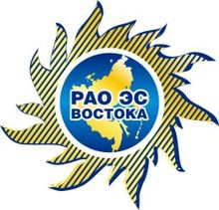








Innovation Development Programs
15 innovation development programs, in 6 of which TPU acts as a base university:
Gazprom
Rosatom
ISS-Reshetnev Company
NPO Microgen
System Operator of the Unified Energy System of Russia (SO UPS)
RAO Energy Systems of the East (RAO ES of East)
ROSCOSMOS
Rosneft
Transneft
ALROSA
Federal Grid Company of Unified Energy System
Rostec Corporation
Russian Railways
S.P. Korolev Rocket and Space Corporation Energia
All-Russian Scientific Research Institute of Aviation Materials
KAMAZ
24

Slide 25


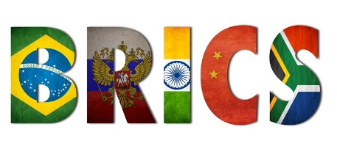





International Recognition
TPU is a member of 9 international associations and consortiums,
including CESAER (Conference of European Schools for Advanced Engineering Education and Research), CLUSTER (Consortium of Leading European and Asian Technical Universities)
TPU is a participant of the BRICS Network University
Sino-Russian Think Tank in the framework of One Belt and One Road Initiative established at TPU jointly with the Chinese Academy of Science and Technology for Development (CASTED). Its strategic goal is to assess the social and economic impact of engineering solutions
Research centers of world corporations-partners of TPU:
25

Slide 26
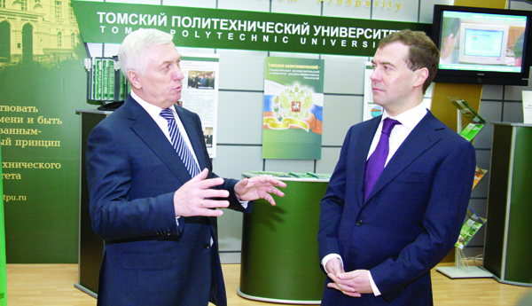
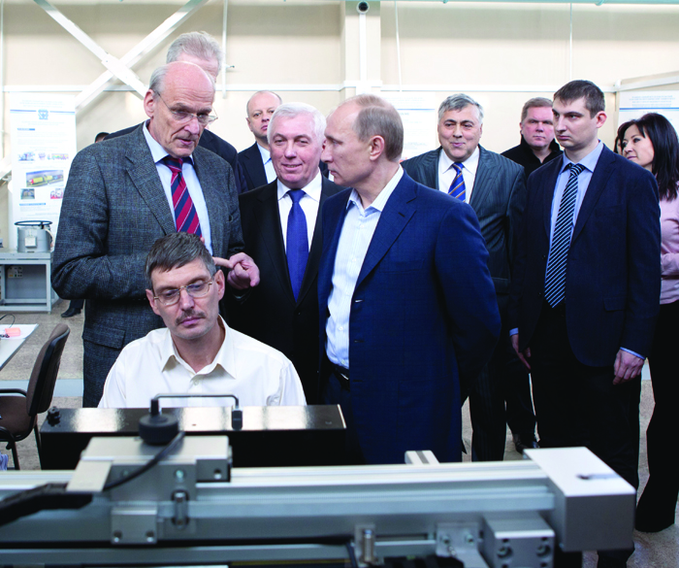
Visits by country leaders
11 February 2010 - President of the Russian Federation Dmitry A. Medvedev (at present the Prime Minister of the Russian Federation)
25 January 2012 – Prime Minister of the Russian Federation Vladimir V. Putin (since May 7, 2012 – the President of the Russian Federation)
26

Slide 27
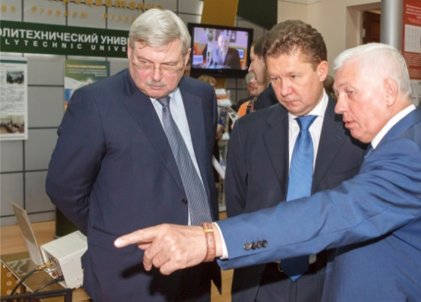
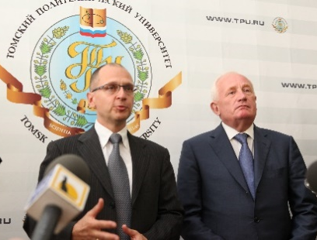
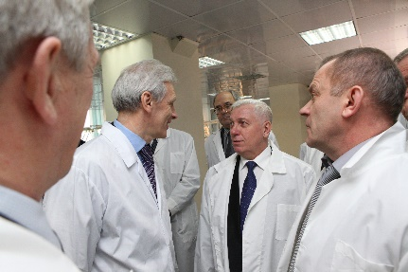
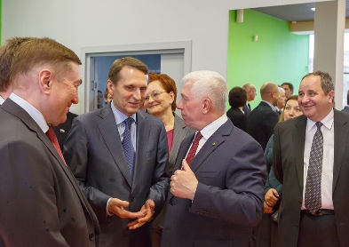
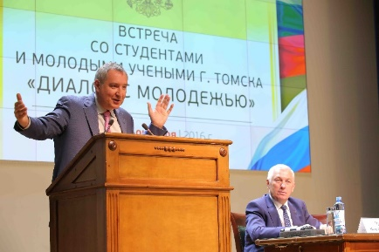
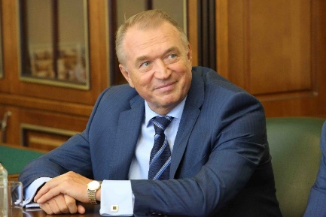
Other VIP guests at TPU from 2009 to 2018
Ambassadors of: Algeria, Belgium, the Republic of Benin, Great Britain, Germany, Denmark, India, Indonesia, Jordan, Ireland, France, European Union, the Netherlands
Sergey Naryshkin, Chairman of the RF State Duma, at present – Director of Foreign Intelligent Service
Arkady Dvorkovich, Deputy Prime Minister of the Russian Federation
Dmitri Rogozin, Deputy Prime Minister of the Russian Federation
Sergei Katyrin, President of the RF Chamber of Commerce and Industry
Anatoly Chubais, Chairman of the Executive Board of RUSNANO MC LLC
Andrey Fursenko, Minister of Education and Science, at present – Aide to the President of the Russian Federation
Dmitry Livanov, Minister of Education and Science of the Russian Federation, at present – special presidential representative for the development of trade and economic relations with Ukraine
Sergey Donskoy, Minister of Natural Resources and Environment of Russia
Yuri Osipov, President of the Russian Academy of Sciences, at present – RAS Presidium Member
Alexey Miller, Chairman of the Management Committee, Gazprom
Sergey Kirienko, CEO of Rosatom State Corporation, at present – First Deputy Chief of Staff of the Presidential Administration of Russia
27

Slide 28
Government Awards
Prize of the Government of the Russian Federation in education:
S.V. Kirsanov (2009)
М.G. Minin (2009)
TPU represented by P.S. Chubik, Yu.P. Pokholkov, A.I. Chuchalin and A.P. Surzhikov (2011)
Prize of the Government of the Russian Federation in science and technology for young scientists:
G.V. Kuznetsov, O.V. Vysokomornaya, D.O. Glushkov, A.V. Zakharevich, P.A. Strizhak (2012)
D.M. Sonkin (2014)
M.V. Andreev, N.Yu. Ruban, A.A. Suvorov, R.A. Ufa, Yu.S. Borovikov (2017)
Prize of the Government of the Russian Federation in science and technology:
M.A. Sonkin, V.Z. Yampolsky (2013)
M.M. Shtein (2013)
28

Slide 29
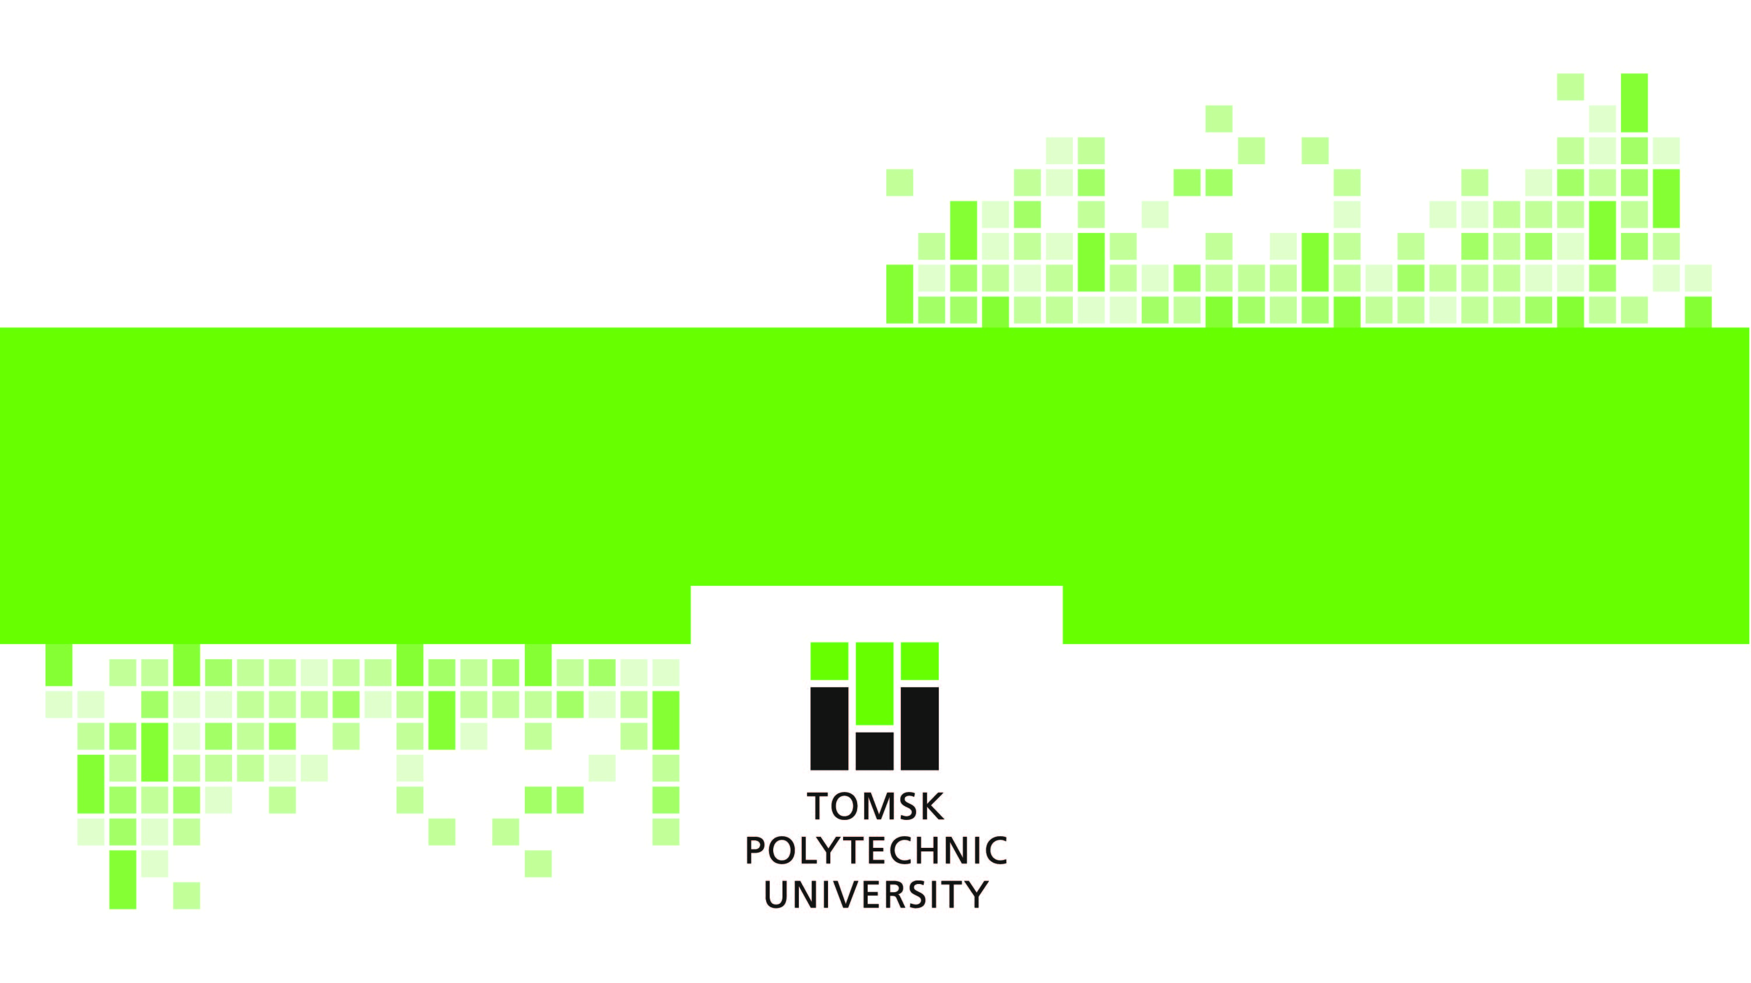
THANK YOU!

